Slide 1



Stay Clean from COVID-19
What do I need to clean?
Examples of frequently touched surfaces and objects that will need routine disinfection following reopening are:
• Tables
• Doorknobs
• Light switches
• Countertops
• Handles
• Desks
• Keyboards
• Gas pump handles
• Touch screens
• ATM machines
• Sign-in kiosks
• Phones
• Faucets and sinks
• Toilets
Cleaning staff is available, but do not clean after every instance of potential exposure. This means it is your job take action. By creating plans for your work sections and common areas we can win the fight against COVID-19.
Produced by Aviano AB, Public Health using CDC & Army Public Health Center guidelines
DSN: 314-632-3998
Approved by 31 MDG/SGP
For more information, please visit CDC.GOV

Slide 2
How to Clean
Clean
Wear disposable gloves to clean and disinfect
Clean surfaces using soap and water to remove germs/dirt
Disinfect next to kill germs on surfaces
Practice routine cleaning of frequently touched surfaces
Disinfect
Household cleaners and disinfectants: clean the area or item with
soap and water. Then use an EPA registered household disinfectant
(see CDC.gov if unsure)
Use diluted household bleach solution on hard surfaces
  1/3 cup bleach per gallon of water
Soft Surfaces
For soft surfaces (carpets, rugs, drapes) remove visible soil and then
launder.
If not possible to launder, disinfect with an EPA-registered
disinfectant
Laundry
Wash clothing and bed linens weekly with detergent and warm water
Dry completely
Do not shake dirty laundry
Clean/disinfect hampers
Produced by Aviano AB, Public Health using CDC & Army Public Health Center guidelines
DSN: 314-632-3998
Approved by 31 MDG/SGP
For more information, please visit CDC.GOV

Slide 3
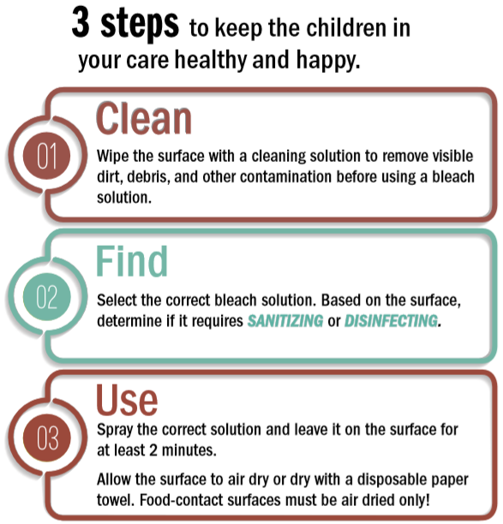
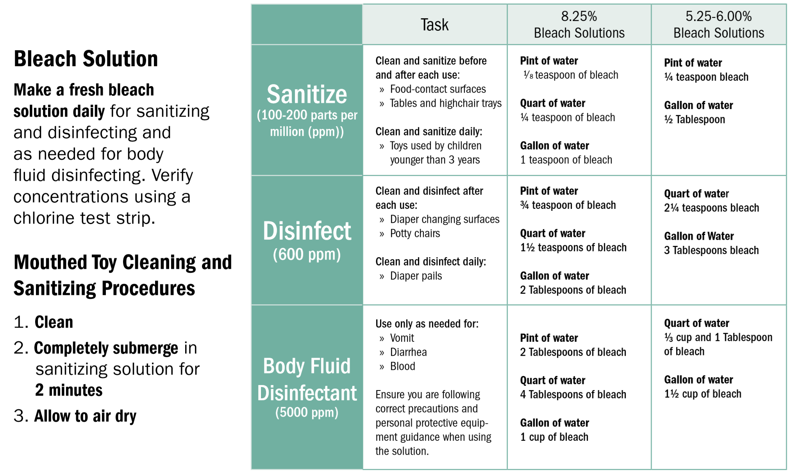
Cleaning for our children
Produced by Aviano AB, Public Health using CDC & Army Public Health Center guidelines
DSN: 314-632-3998
Approved by 31 MDG/SGP
For more information, please visit CDC.GOV
https://ephc.amedd.army.mil/HIPECatalog/viewItem.aspx?id=785

Slide 4






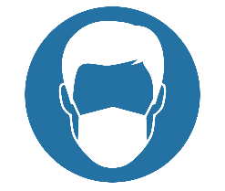
When Using Restrooms, Breakrooms, and other common areas
Contamination Hazard!
Frequently touched surfaces are a potential means of contagion
Use hand sanitizers or wash your hands frequently (i.e. self-cleaning sanitation stations)
Avoid gathering. Staggered entry only.
Ensure safety social distance (at least 2 meter/6 feet). When needed access one at a time
Ventilate frequently.
Limit your stay to the necessary time and leave the changing room to allow other workers to use it safely.
Correctly wear proper masks and gloves
(gloves, where needed)
Produced by Aviano AB, Public Health using CDC & Army Public Health Center guidelines
DSN: 314-632-3998
Approved by 31 MDG/SGP
For more information, please visit CDC.GOV

